Slide 1
Chapter3
Public-Key Cryptography and Message Authentication
Notes:
两个内容，一个是公钥机制，另一个是消息认证。

Slide 2
OUTLINE
Approaches to Message Authentication
Secure Hash Functions and HMAC
Public-Key Cryptography Principles
Public-Key Cryptography Algorithms
Digital Signatures
Key Management
Notes:
要点：

Slide 3
Authentication
Requirements - must be able to verify that:
1. Message came from apparent source or author,
2. Contents have not been altered,
3. Sometimes, it was sent at a certain time or sequence.
Protection against active attack (falsification of data and transactions)
Notes:
认证，我们要达到什么样的目的，或者说有什么需求。
1。消息来自于声称的源或作者（消息来源认证）
2。内容没有被修改（消息内容认证）
3。按时、按序到达

Slide 4
3.1 Approaches to Message Authentication
Authentication Using Conventional Encryption
  Only the sender and receiver should share a key
Message Authentication without Message Encryption
  An authentication tag is generated and appended to each message
(1)Message Authentication Code
  Calculate the MAC as a function of the message and the key. MAC = F(K, M)
Notes:
1、有传统加密进行认证：依据一个假设：只有发送者和接收者共享密钥，那么，一个发送方加密的消息，只有共享密钥的一方才能正确解密。通过使用检错码、序列号和时间戳
2、不加密消息的认证
主要用于消息只需要认证而无须保密的情形，如：广播消息、程序认证
有两种形式：MAC和HASH

Slide 5
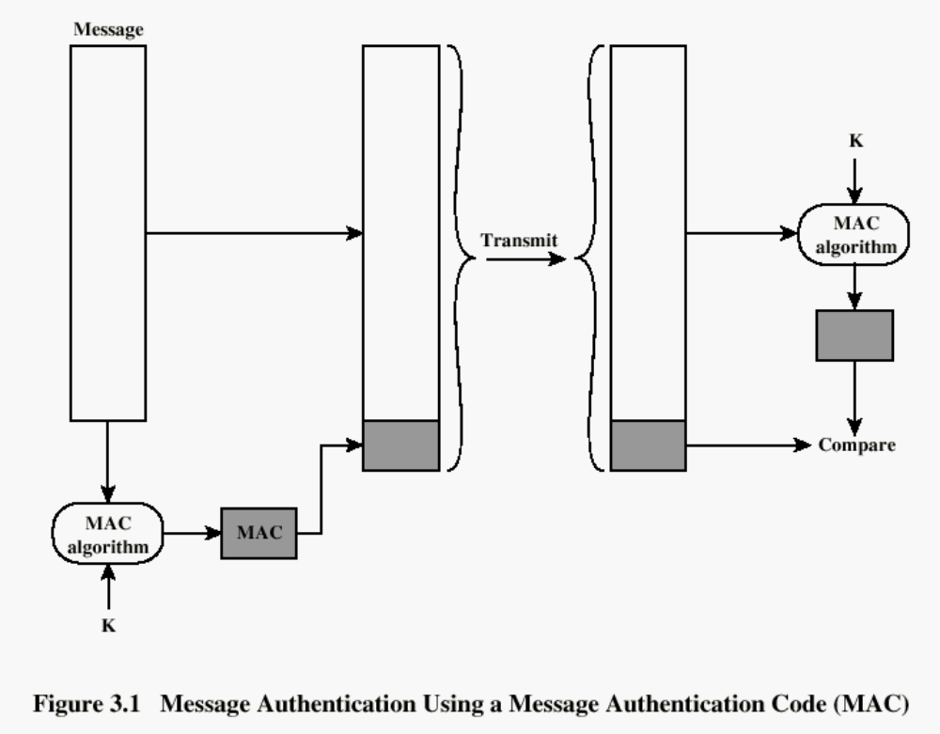

Slide 6
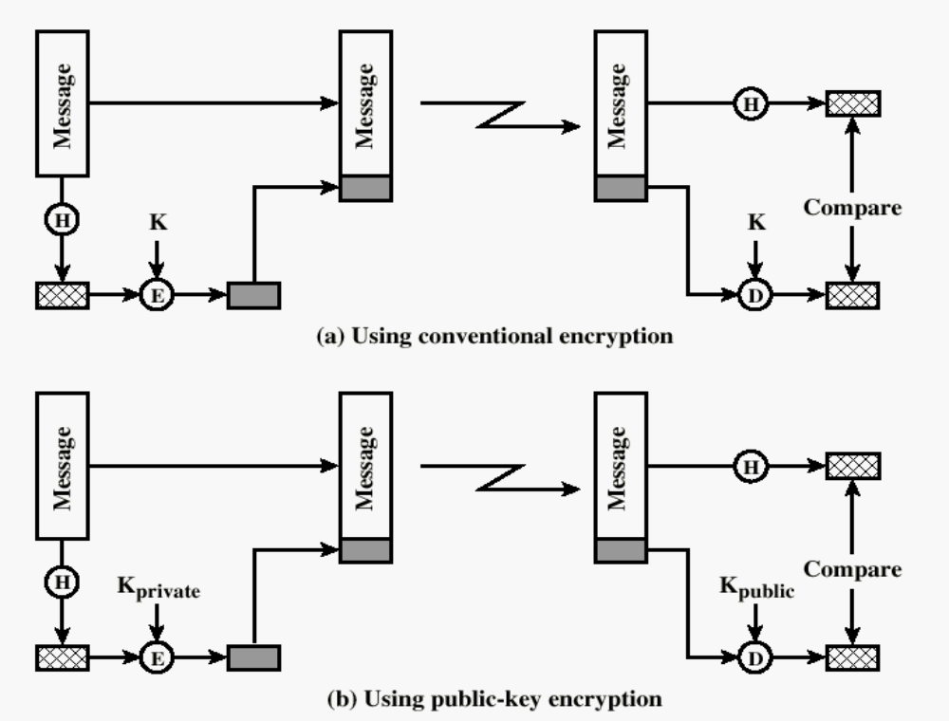
(2) One-way HASH function
Notes:
可使用对称加密机制和非对称加密实现消息的认证（包括消息来源认证和消息内容认证）
使用非对称加密的认证标签还提供了数字签名的功能。签名可被多个接收方认证

Slide 7
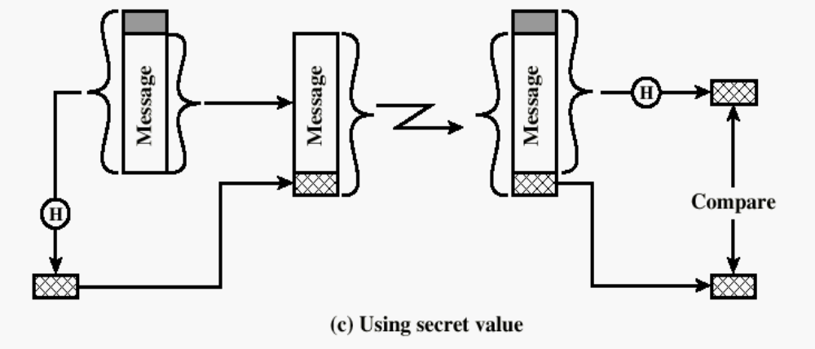
One-way HASH function with secret value
Secret value is added before the hash and removed before transmission.
Notes:
使用秘密值的的消息认证。这里避免使用了加密，有以下好处：
使用软件加密慢，使用硬件成本高，加密硬件仅对大数据块优化，加密算法受专利保护，加密算法受出口限制。
秘密值在发送方和接收方之间共享，不传递，因而攻击者不能改消息内容，也不能假冒发送方产生消息。

Slide 8
3.2 Secure HASH Functions
Purpose of the HASH function is to produce a ”fingerprint” of a message.
Notes:
思考：人类的指纹具有什么特征及用途？
具有唯一性，不同的人不会有相同的指纹。
那么，可以用指纹对人的身份进行认证，如指纹识别，

Slide 9
Hash Functions: Main Idea
hash function H
.
message
message
“digest”
x
.
.
y
.
x’’
.
y’
x’
bit strings of any length
n-bit bit strings
H is a lossy compression function
  Collisions: h(x)=h(x’) for some inputs x, x’
  Result of hashing should “look random” Intuition:
  ½ of digest bits are “1”; any bit in digest is “1” half the time
Cryptographic hash function needs a few properties…
Notes:
消息摘要
碰撞
消息摘要的随机性：摘要1/2的位为1,任何位为1的几率是1/2
密码学中的散列函数需要具备一些性质：

Slide 10
Properties of a HASH function H :
  H can be applied to a block of data at any size(输入)
  H produces a fixed length output（输出）
  H(x) is easy to compute for any given x.（易计算）
  For any given value h, it is computationally infeasible to find x such that H(x) = h（单向）
  For any given block x, it is computationally infeasible to find y≠ x with H(y) = H(x).（弱碰撞抵抗）
  It is computationally infeasible to find any pair (x, y) such that H(x) = H(y) （强碰撞抵抗）
Notes:
单向：一个方向计算容易，反向计算很难
弱碰撞抵抗：不能找以另外一个消息y产生与z相同的摘要。
符合前五条的散列函数称为：弱散列函灵敏
符合所有六条的称为：强散列函数

Slide 11
interpretation
The first three properties are requirement for the practical application of hash function to message authentication.
The forth properties is the “one-way” property.
The fifth properties is weak collision resistance
The sixth properties is strong collision resistance
Notes:
生日问题：
假设每个人的生日在一年的365天中的任意一天的可能性是相同的，那么随机找n个人（不超过365人），这n 个人生日各不相同的概率应该是多少？

Slide 12
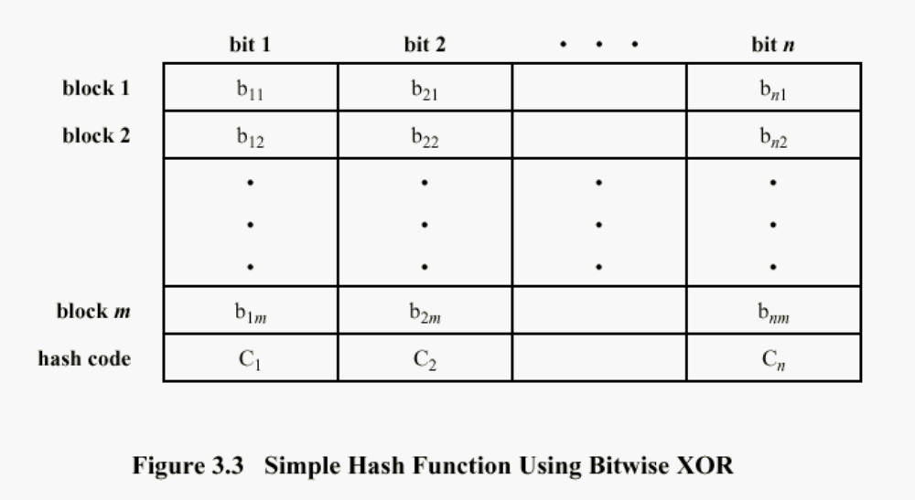
Simple Hash Function
With more formatted data ,the function is less effective. e.g. normal text files,the high-order bit is always zero,so if a 128-bit function, the virtually effectiveness is 2⁻¹¹²
Notes:
纵向冗余校验：把消息分成n bit的块，然后每块进行按位异或。
因为散列值的每一位都有两种可能的取值1或0，那么如果块数据有错误，那么散列值的每一位不发生改变的概率为1/2，所有位都不发生改变的概率为1/2^{n}

Slide 13
Improvement of longitudinal redundancy check
One-bit circular shift on the hash value after each block is processed would improve
1. Initially set the n-bit hash value to zero
2. Process each successive n-bit block of data as follows:
Rotate the current hash value to the left by one bit;
XOR the block into the hash value

Slide 14
Attacks on Hash Functions
have brute-force attacks and cryptanalysis
a preimage or second preimage attack
  find y s.t. H(y) equals a given hash value
collision resistance
  find two messages x & y with same hash so H(x) = H(y)
hence value 2^{m/2} determines strength of hash code against brute-force attacks
  128-bits inadequate, 160-bits suspect
Notes:
As with encryption algorithms, there are two categories of attacks on hash functions: brute-force attacks and cryptanalysis. A brute-force attack does not depend on the specific algorithm but depends only on bit length. In the case of a hash function, a brute-force attack depends only on the bit length of the hash value. A cryptanalysis, in contrast, is an attack based on weaknesses in a particular cryptographic algorithm.
For a preimage or second preimage attack, an adversary wishes to find a value y such that H(y) is equal to a given hash value h. The brute force method is to pick values of y at random and try each value until a collision occurs. For an m-bit hash value, the level of effort is proportional to 2^{m}. Specifically, the adversary would have to try, on average, 2^{m–1} values of y to find one that generates a given hash value h.
For a collision resistant attack, an adversary wishes to find two messages or data blocks, x and y, that yield the same hash function: H(x) = H(y). This requires much less effort than a preimage or second preimage attack. The effort required is explained by a mathematical result referred to as the birthday paradox (next slide).
If collision resistance is required, then the value 2^{m/2} determines the strength of the hash code against brute-force attacks. Van Oorschot and Wiener presented a design for a $10 million collision search machine for MD5, which has a 128-bit hash length, that could find a collision in 24 days. Thus a 128-bit code may be viewed as inadequate. The next step up, if a hash code is treated as a sequence of 32 bits, is a 160-bit hash length. With a hash length of 160 bits, the same search machine would require over four thousand years to find a collision. With today's technology, the time would be much shorter, so that 160 bits now appears suspect.

Slide 15
Secure Hash Algorithm
SHA originally designed by NIST & NSA in 1993
was revised in 1995 as SHA-1
US standard for use with DSA signature scheme
  standard is FIPS 180-1 1995, also Internet RFC3174
  nb. the algorithm is SHA, the standard is SHS
based on design of MD4 with key differences
produces 160-bit hash values
recent 2005 results on security of SHA-1 have raised concerns on its use in future applications
Notes:
In recent years, the most widely used hash function has been the Secure Hash Algorithm (SHA). The Secure Hash Algorithm (SHA) was developed by the National Institute of Standards and Technology (NIST) and published as a federal information processing standard (FIPS 180) in 1993; a revised version was issued as FIPS 180-1 in 1995 and is generally referred to as SHA-1. The actual standards document is entitled Secure Hash Standard. SHA is based on the hash function MD4 and its design closely models MD4. SHA-1 produces a hash value of 160 bits. In 2005, a research team described an attack in which two separate messages could be found that deliver the same SHA-1 hash using 2^69 operations, far fewer than the 2^80 operations previously thought needed to find a collision with an SHA-1 hash [WANG05]. This result has hastened the transition to newer, longer versions of SHA.

Slide 16
Revised Secure Hash Standard
NIST issued revision FIPS 180-2 in 2002
adds 3 additional versions of SHA
  SHA-256, SHA-384, SHA-512
designed for compatibility with increased security provided by the AES cipher
structure & detail is similar to SHA-1
hence analysis should be similar
but security levels are rather higher
Notes:
In 2002, NIST produced a revised version of the standard, FIPS 180-2, that defined three new versions of SHA, with hash value lengths of 256, 384, and 512 bits, known as SHA-256, SHA-384, and SHA-512. Collectively, these hash algorithms are known as SHA-2. These new versions have the same underlying structure and use the same types of modular arithmetic and logical binary operations as SHA-1, hence analyses should be similar. A revised document was issued as FIP PUB 180-3 in 2008, which added a 224-bit version. SHA-2 is also specified in RFC 4634, which essentially duplicates the material in FIPS 180-3, but adds a C code implementation.
In 2005, NIST announced the intention to phase out approval of SHA-1 and move to a reliance on the other SHA versions by 2010.

Slide 17
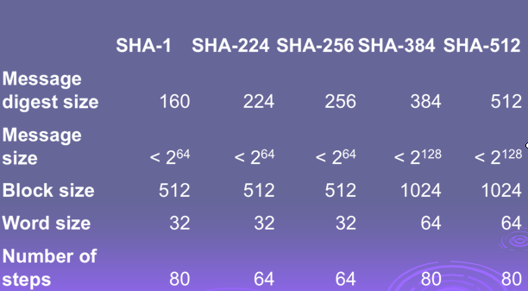
SHA Versions
Notes:
Stallings Table 3.1 provides a comparison of the various parameters for the SHA hash functions.

Slide 18
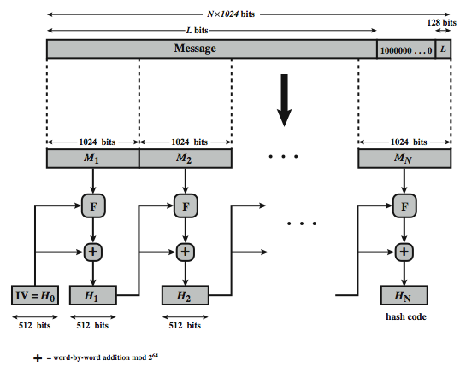
SHA-512 Overview
Notes:
Now examine the structure of SHA-512, noting that the other versions are quite similar.
SHA-512 follows the structure depicted in Stallings Figure 3.4. The processing consists of the following steps:
• Step 1: Append padding bits, consists of a single 1-bit followed by the necessary number of 0-bits, so that its length is congruent to 896 modulo 1024
• Step 2: Append length as an (big-endian) unsigned 128-bit integer
• Step 3: Initialize hash buffer to a set of 64-bit integer constants (see text)
• Step 4: Process the message in 1024-bit (128-word) blocks, which forms the heart of the algorithm. Each round takes as input the 512-bit buffer value H_{i}, and updates the contents of that buffer.
• Step 5: Output the final state value as the resulting hash
See text for more details.

Slide 19
Processing steps of SHA
(1)Append padding bits
(2)Append length
(3)Initalize hash buffer
(4)Processing Msg. in 1024-bit block
(5)Output
(pp.71~72)

Slide 20
SHA-512 Compression Function
Heart of the algorithm
processing message in 1024-bit blocks
consists of 80 rounds
  updating a 512-bit buffer
  using a 64-bit value Wt derived from the current message block
  and a round constant based on cube root of first 80 prime numbers
Notes:
The SHA-512 Compression Function is the heart of the algorithm. In this Step 4, it processes the message in 1024-bit (128-word) blocks, using a module that consists of 80 rounds, labeled F in Stallings Figure 11.8, and is shown in detail in Figure 11.9. Each round takes as input the 512-bit buffer value, and updates the contents of the buffer. At input to the first round, the buffer has the value of the intermediate hash value. Each round t makes use of a 64-bit value Wt derived using a message schedule from the current 1024-bit block being processed. Each round also makes use of an additive constant Kt, based on the fractional parts of the cube roots of the first eighty prime numbers. The constants provide a “randomized” set of 64-bit patterns, which should eliminate any regularities in the input data. The output of the eightieth round is added to the input to the first round to produce the final hash value for this message block, which forms the input to the next iteration of this compression function, as shown on the previous slide.

Slide 21
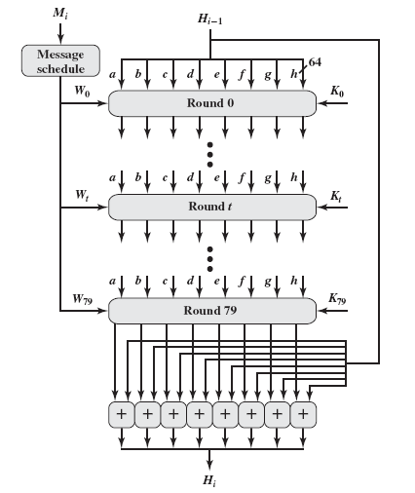
Processing of single Block
Notes:
四轮，每轮20步，每一轮使用的逻辑函数不同（f1,f2,f3,f4）

Slide 22
3.3 HMAC
Use a MAC derived from a cryptographic hash code, such as SHA-1.
Motivations:
  Cryptographic hash functions executes faster in software than encryptoin algorithms such as DES
  Library code for cryptographic hash functions is widely available
  No export restrictions from the US

Slide 23
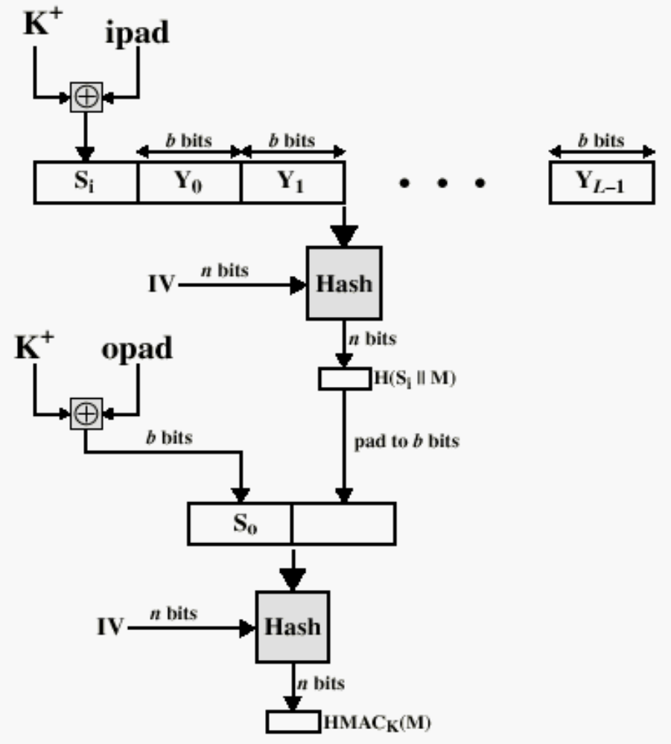
HMAC Structure
Notes:
H-散列算法
Yi 消息的第I个块
B 块的大小，块中的位数
N Hash值的位数
K 秘密密钥
K+ ：K左端填0成为b位
Ipad:填充00110110 b/8次，成为b位
Opad:填充010101100 b/8次，成为b位

Slide 24
3.4 Public-Key Cryptography Principles
It’s the truly revolutionary advance in encryption in thousands of years.
The use of two keys has consequences in: key distribution, confidentiality and authentication.
It based on mathematical function rather than on simple operations on bit patterns.

Slide 25
Two misconceptions concerning public-key enctryption.(see page 79~80)
1.Public –key encryption is more secure from
cryptanalysis than conventional encryption.
(security depends on length of key and computational work
involved in breaking a cipher)
2.Public-key encryption made conventional
encryption obsolete.
(for the computational overhead of public-key encryption,there is no
foreseeable likelihood that conventional encryption will be abandoned)

Slide 26
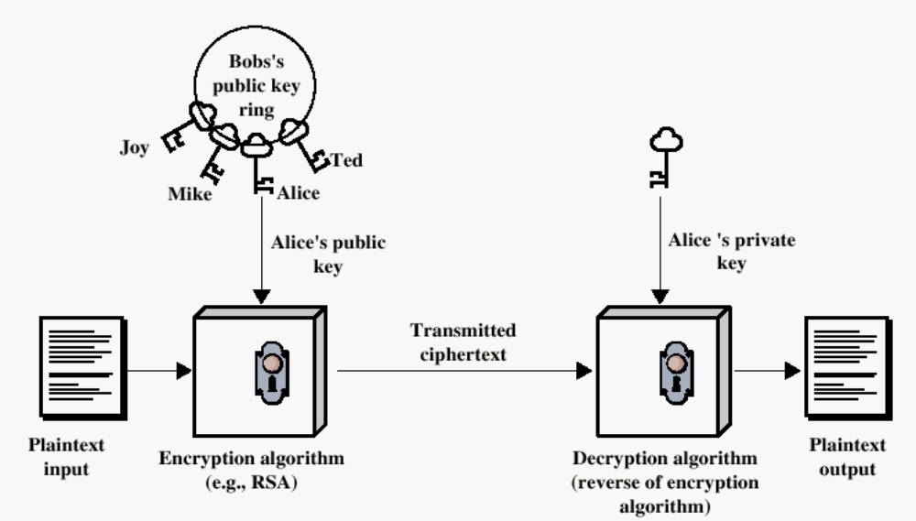
Encryption using Public-Key system

Slide 27
The Public-Key scheme has six ingredients
(see Figure 3.9)
  Plaintext
  Encryption algorithm
  Public key
  Private key
  Ciphertext
  Decryption algorithm

Slide 28
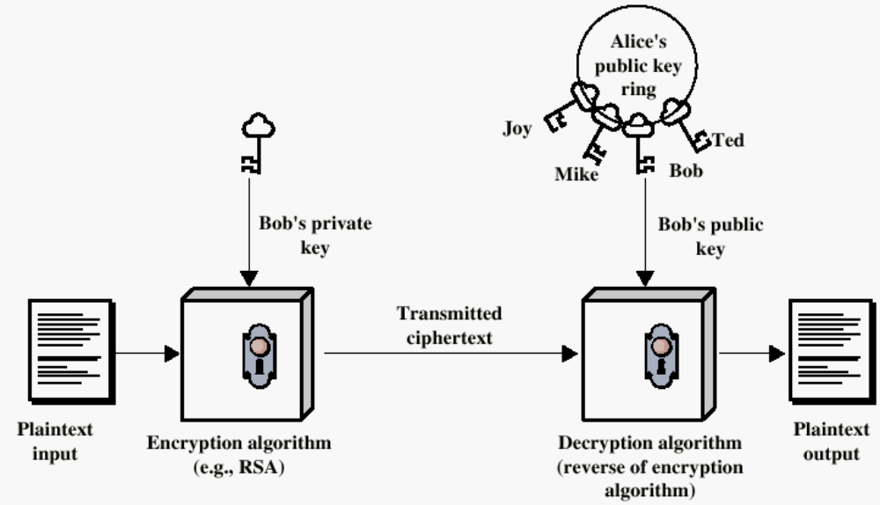
Authentication using Public-Key System

Slide 29
Applications for Public-Key Cryptosystems
Three categories:
  Encryption/decryption: The sender encrypts a message with the recipient’s public key.
  Digital signature: The sender ”signs” a message with its private key.
  Key echange: Two sides cooperate to exhange a session key.

Slide 30
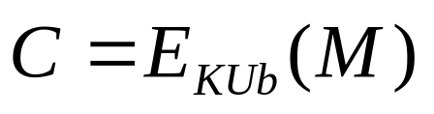
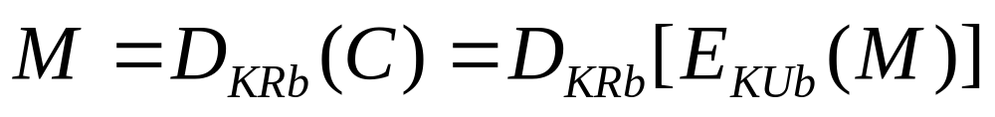
Requirements for Public-Key Cryptography
Computationally easy for a party B to generate a pair (public key KUb, private key KR_{b})
Easy for sender to generate ciphertext:
Easy for the receiver to decrypt ciphertect using private key:

Slide 31
Requirements for Public-Key Cryptography
Computationally infeasible to determine private key (KR_{b}) knowing public key (KU_{b})
Computationally infeasible to recover message M, knowing KU_{b} and ciphertext C
Either of the two keys can be used for encryption, with the other used for decryption:

Slide 32
3.5 Public-Key Cryptographic Algorithms
RSA and Diffie-Hellman
RSA - Ron Rivest, Adi Shamir and Len Adleman at MIT, in 1977.
  RSA is a block cipher
  The most widely implemented
Diffie-Hellman
  Echange a secret key securely
  Compute discrete logarithms

Slide 33



1.RSA Public Key Cryptosystem
The Inventors
  R - Ron Rivest
  S - Adi Shamir
  A - Leonard Adleman
The One-Way Function
  The exponentiation function y = f(x) = x^{e} mod n can be computed with reasonable effort.
  Its inverse x = f ⁻¹(y) is extremely difficult to compute.
The Hard Problem Securing the Trapdoor
  The RSA public key algorithm is based on the well-known hard problem of factoring large numbers into its prime factors that has been studied over many centuries.
Notes:
RSA算法是一种分组密码体制算法，它的保密强度是建立在具有大素数因子的合数，其因子分解是困难的。是否是NP问题尚未确定。
RSA得到了世界上的最广泛的应用，ISO在1992年颁布的国际标准X.509中,将RSA算法正式纳入国际标准。1999年美国参议院已通过了立法，规定电子数字签名与手写签名的文件、邮件在美国具有同等的法律效力。

Slide 34
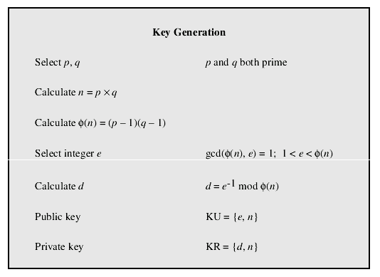
The RSA Algorithm

Slide 35
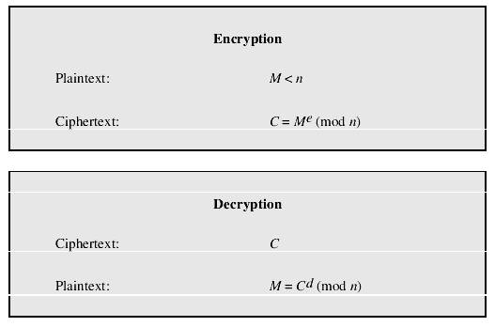

Slide 36
Key Generation Example
p = 3, q = 11: n = p·q = 33
(p-1)·(q-1) = 2 · 10 = 2 · 2 · 5 = 20
the public exponent e must be relatively prime to (p-1)·(q-1) ,
i.e. it cannot contain any factors of 2 and 5
e d e·d e·d mod 20
3 7 21 1
7 3 21 1
9 9 81 1
11 11 121 1
13 17 221 1
17 13 221 1
19 19 361 1
all possible choices for
the exponents e and d

Slide 37
Example of RSA Algorithm
①选择素数: p=17 & q=11
②计算n = pq =17×11=187
③计算ø(n)=(p–1)(q-1)=16×10=160
④选择e : gcd(e,160)=1; 选择e=7
⑤确定d: de=1 mod 160 且 d < 160， d=23
因为23×7=161= 1×160+1
⑥公钥KU={7,187}
⑦私钥KR={23,187}
假设给定的消息为：M=88，则
• 加密:C = 88⁷ mod 187 = 11
• 解密:M = 11²³ mod 187 = 88

Slide 38
Example of RSA Algorithm
ed=1 mod ø(n) ed mod ø(n)=1
ed- k* ø(n)=1
7*d=1 mod 160
160=7*22+6
7= 6 * 1+1
1=7-6=7-(160-7*22)
=7*23-160
d=23
余数
商
除数

Slide 39
例设p=43,q=59,
n=p•q=43*59=2537,
ϕ(n)=(p-1)(q-1) =42*58 =2436, 取e=13,求e的逆元d
解方程 d • e = 1 mod 2436
2436 =13* 187+ 5, 13= 5 * 2 + 3，5= 3+ 2, 3= 2+ 1
所以1= 3- 2 ，2= 5- 3， 3 =13- 2* 5，5 =2436- 13* 187
1= 3- 2= 3-（ 5- 3）= 2* 3- 5
=2*（ 13- 2* 5）- 5= 2 *13- 5* 5
=2* 13- 5*（ 2436 -13 *187）
=937* 13- 5* 2346
即937* 13 ≡ 1 mod 2436
取e= 13 时d= 937

Slide 40
RSA 的安全性
公开密钥算法
依赖于大数分解，但是否等同于大数分解一直未能证明。
1994年4月26日，美国各大媒体报道：由RSA发明人在17年前出的129位数字已被因子分解
目前，已能分解140位十进制的大素数。因此，模数n必须选大一些。
RSA最快的情况也比DES慢上100倍，无论是软件还是硬件实现。速度一直是RSA的缺陷。一般只用于少量数据加密。

Slide 41
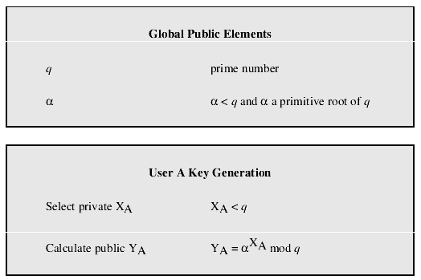
Diffie-Hellman
Key Exchange Algorithm

Slide 42
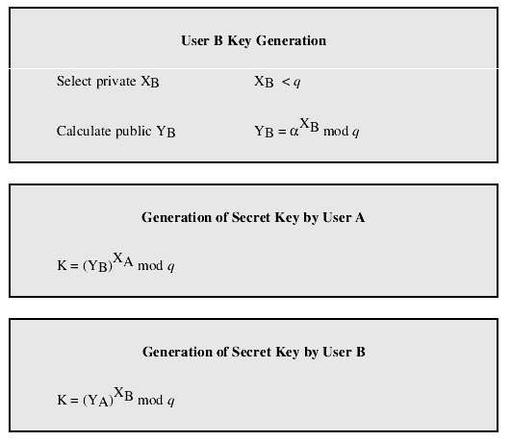

Slide 43
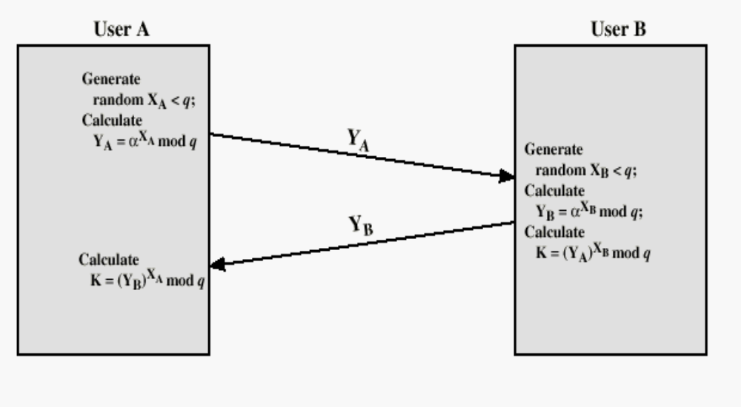
Diffie-Hellman Key Echange

Slide 44
Diffie-Hellman’s security
The security of the Diffie-Hellman key exchange lies in the fact that it is very difficult to calculate discrete logarithms.
For large primes, calculating the discrete logarithms is infeasible.

Slide 45
Other Public-Key Cryptographic Algorithms
Digital Signature Standard (DSS)
  Makes use of the SHA-1
  Not for encryption or key echange
Elliptic-Curve Cryptography (ECC)
  Good for smaller bit size
  Low confidence level, compared with RSA
  Very complex

Slide 46
3.6 Digital Signatures
With public key cryptography, a message can be encrypted with the sender’s private key.
  In this case, the entire message serves as a digital signature
  Disadvantages: speed & storage requirements
Alternative:
  Add a small authentication block to the message
  e.g. take the hash of the message and encrypt just the hash with the sender’s private key
  The result is a much more compact signature

Slide 47
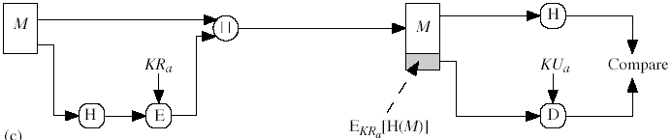
Typical Use of Hash Function with Dig. Sig.
Just sign the hash
  much more efficient than signing full message
KR_{a}: Sender’s Private Key
KU_{a}: Sender’s Public Key

Slide 48
Typical Use of Hash Function with Dig. Sig.
Just sign the hash
  much more efficient than signing full message
KR_{a}: Sender’s Private Key
KU_{a}: Sender’s Public Key
Note: This symbol means concatenate; i.e. join inputs together

